Slide 1

House Price Prediction in the UK using machine learning
MSc Data Science

Slide 2

OVERVIEW
Machine learning can improve house price forecasts, which has a significant impact on the real estate industry. Large-scale data analysis is done by ML, as opposed to traditional approaches, to identify complex trends that improve projections. Big data and quick computation enable machine learning (ML) to detect long-term issues and adjust to changes in the market. The purpose of this study is to investigate potential dangers and opportunities associated with using machine learning (ML) in the housing market.

Slide 3
AIM AND OBJECTIVES
The goal of this project is to reliably forecast UK home values using machine-learning algorithms, enabling knowledgeable real estate market decision-making.
Objectives:
1. Collect and evaluate information about houses, including location, economic factors, historical values, and property details, for the housing industry.
2. Create and implement machine learning algorithms for predicting house values, such as neural networks, clustering, and regression models.
3. Evaluate and contrast scenario performance with industry standards and baseline models.
4. Examine how diversity affects UK housing market growth predictions and factors that influence house prices.
5. Take into account data on machine learning techniques and resources for forecasting house values and other aspects of the UK housing industry.

Slide 4


LITERATURE REVIEW
Machine learning improves predictions of UK house prices, assisting buyers and investors in making wiser choices. It also has to deal with issues like data security and quality, which emphasizes the necessity of preparing data. Neural networks, SVM, Random Forest, Gradient Boosting, and Linear Regression are among the often employed methods.
impact of machine learning on UK home price prediction, highlighting its potential for higher accuracy compared to Traditional techniques. It draws attention to issues including data privacy, data quality, and the requirement for sophisticated models. Important subjects include popular prediction methods, data preparation, and research gaps, with an emphasis on increasing forecasting accuracy.

Slide 5
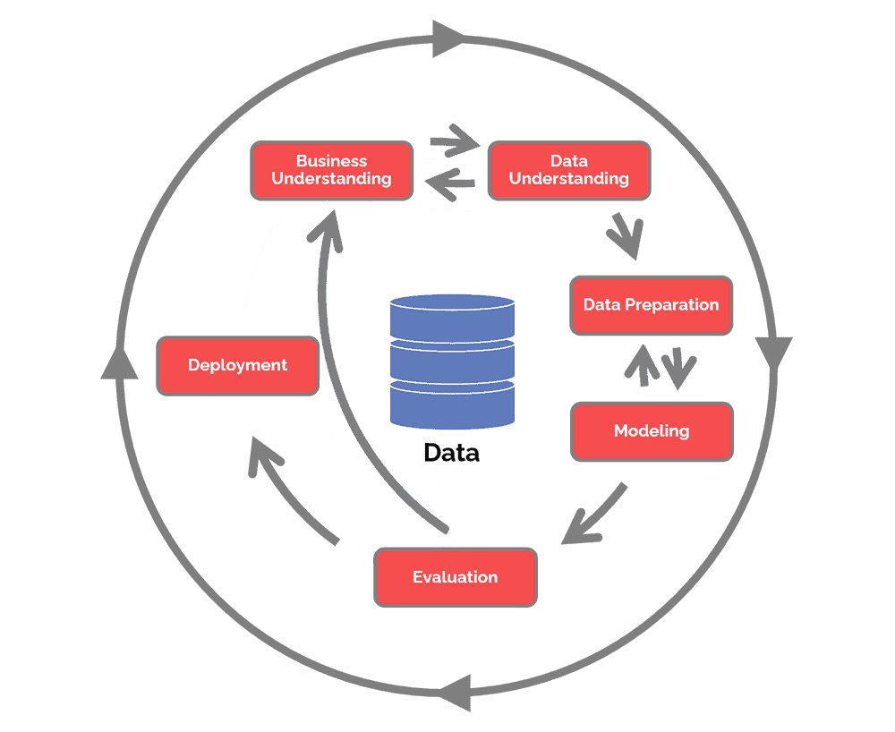
METHODOLOGY (CRISP-DM)
Feature Engineering:-
Evaluation:-
Seasonal Feature
Growth Rate Feature
MACD
EMA
RAI
Trend Feature
MAE
MSE
RMSE
R2 Score

Slide 6
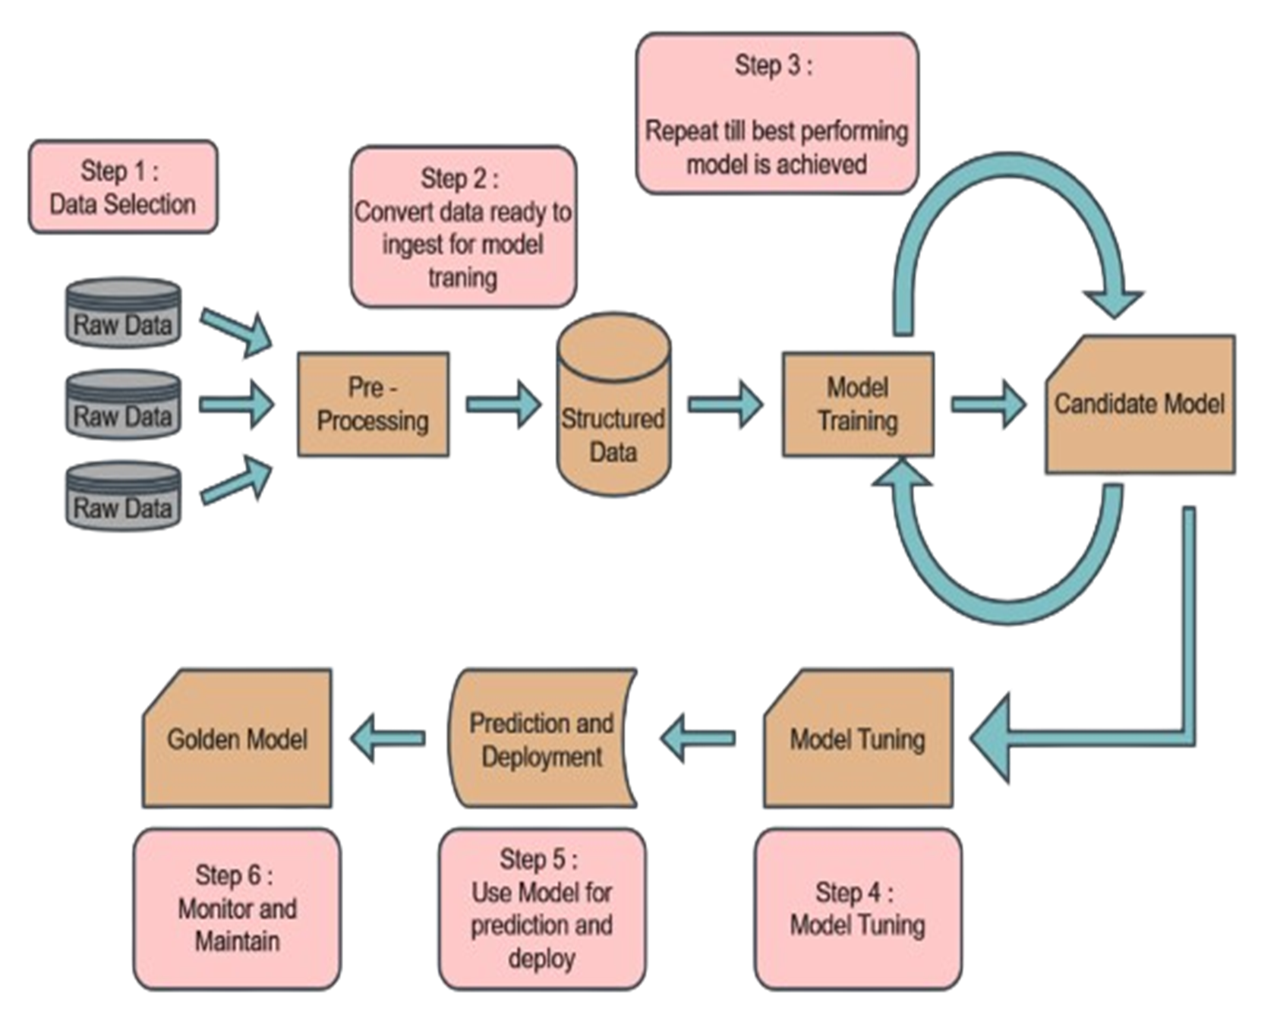
DATAFLOW (overview)

Slide 7
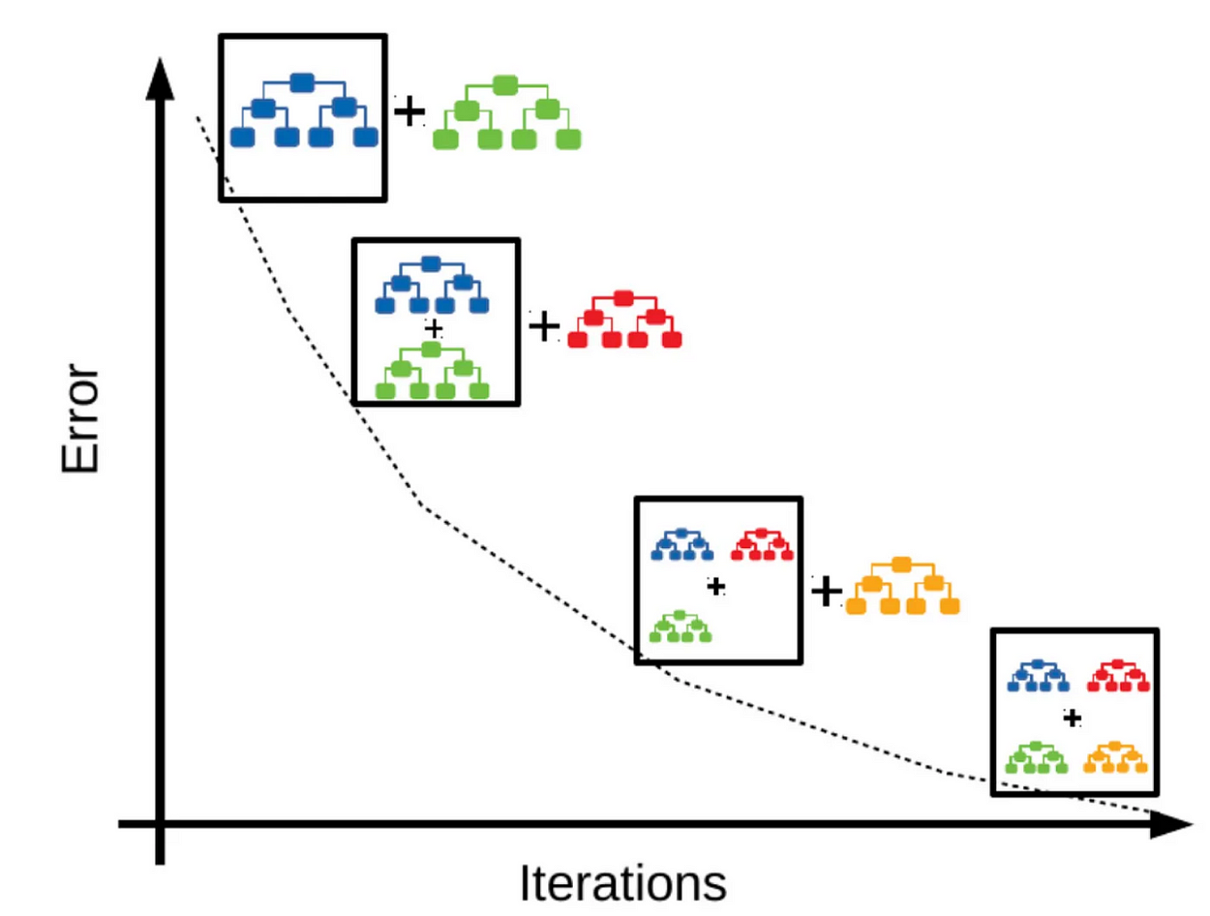
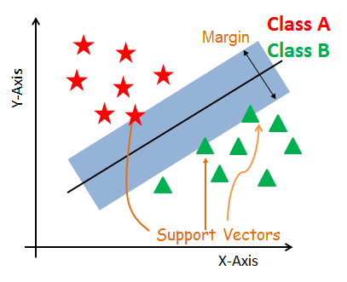
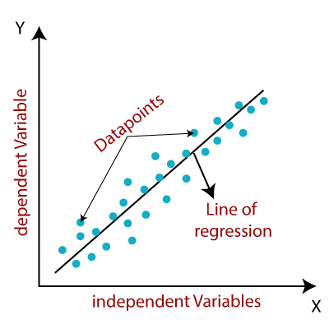
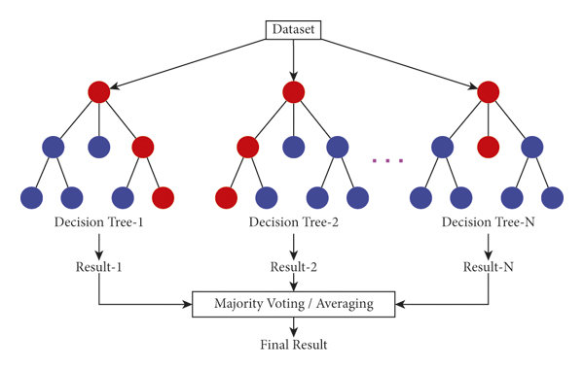
ALGORITHMS USED (MCSA)
Support Vector Machine
Gradient Boost
Linear Regression
Random Forest

Slide 8
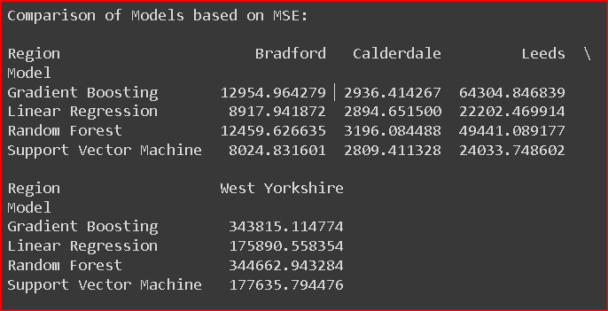
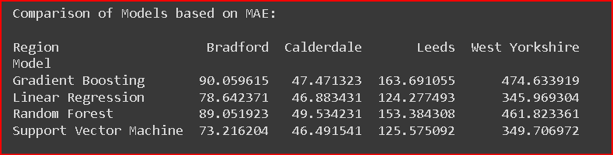
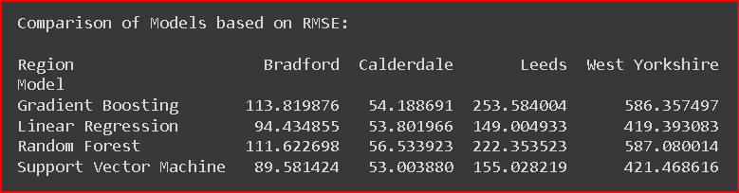
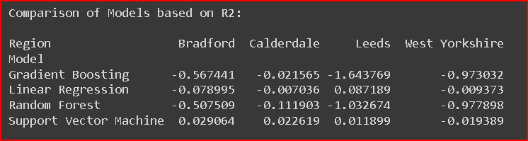
MODEL EVALUATION METRICS
MAE
MSE
RMSE
R2

Slide 9
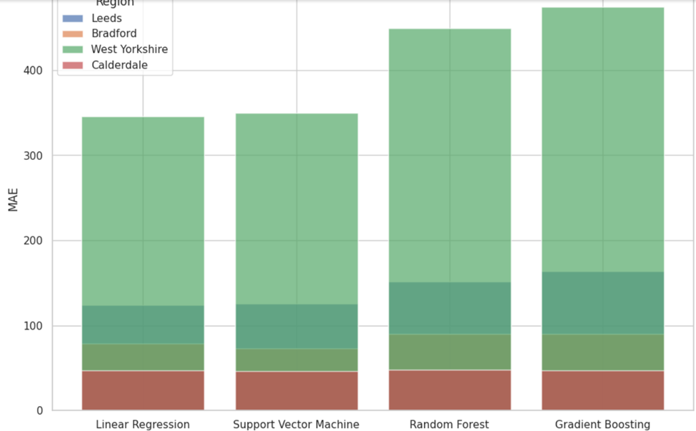
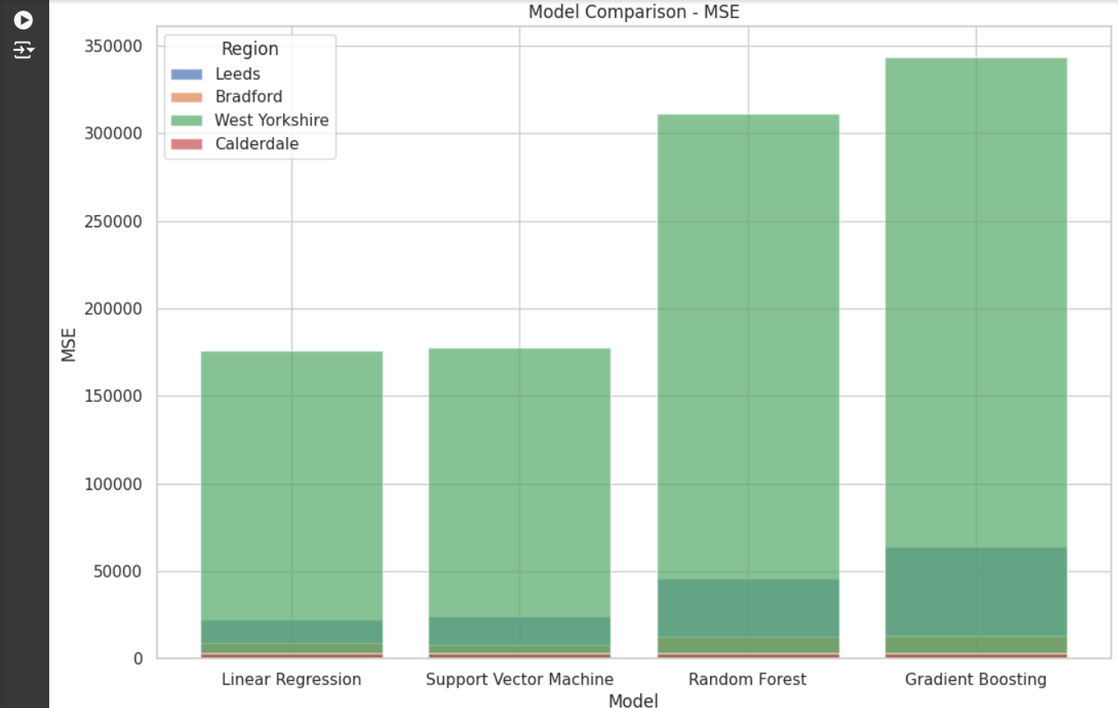
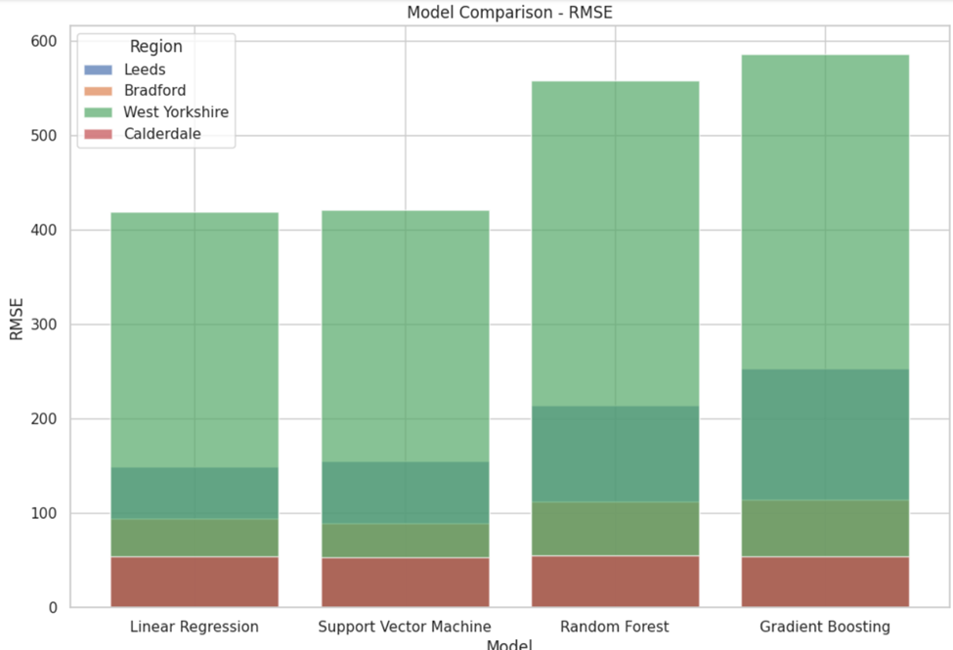
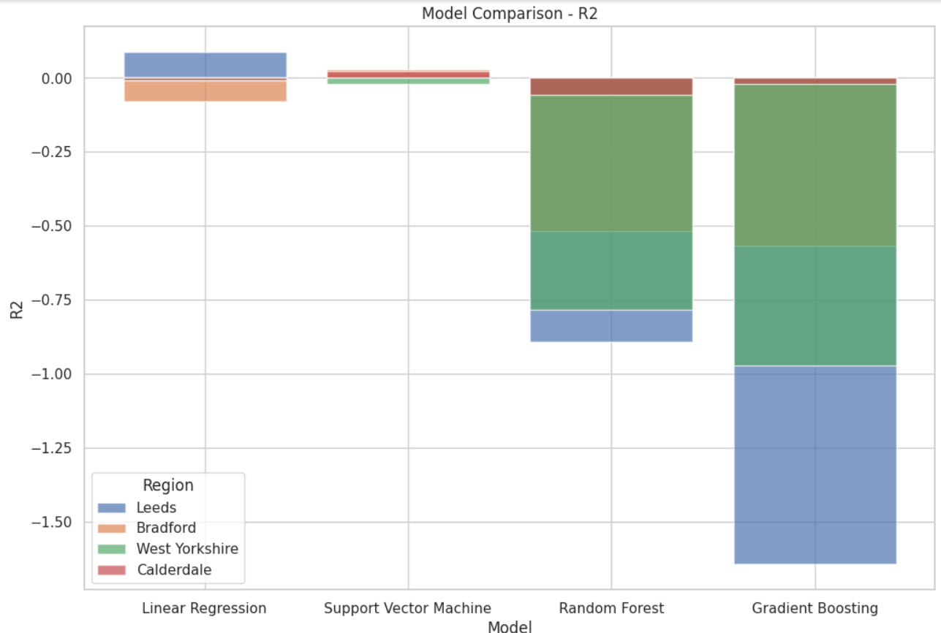
RESEARCH OUTCOME AND DISCUSSION

Slide 10
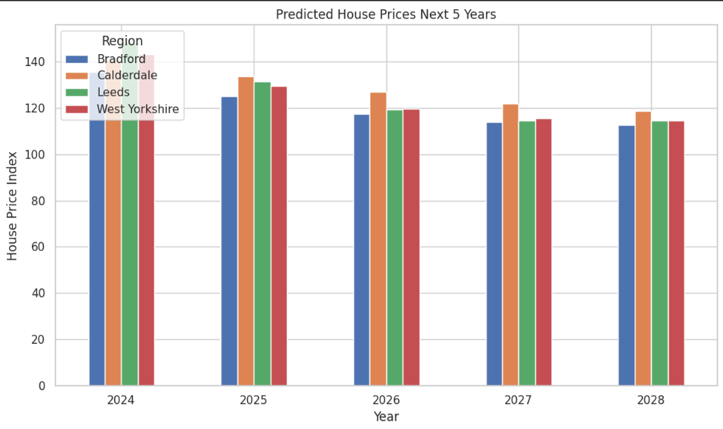
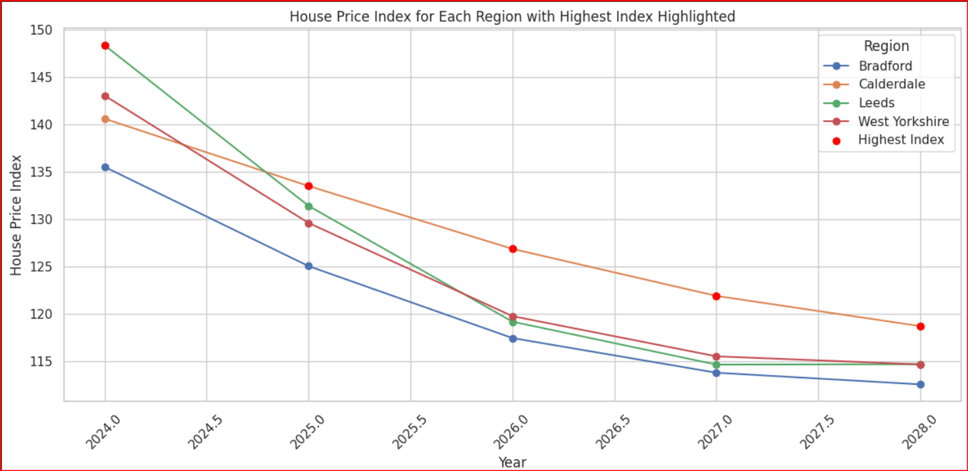
RESEARCH OUTCOME AND DISCUSSION

Slide 11
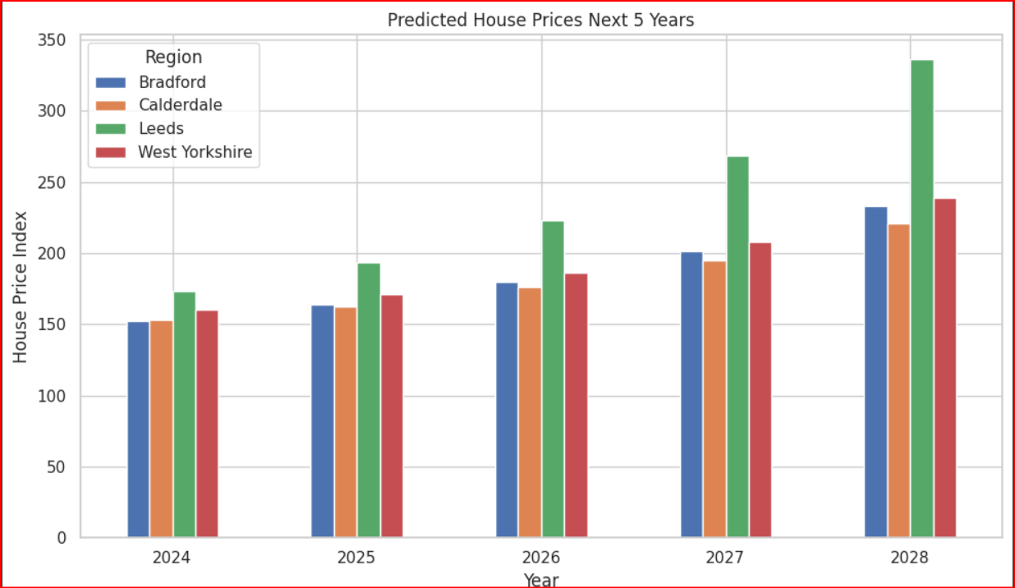
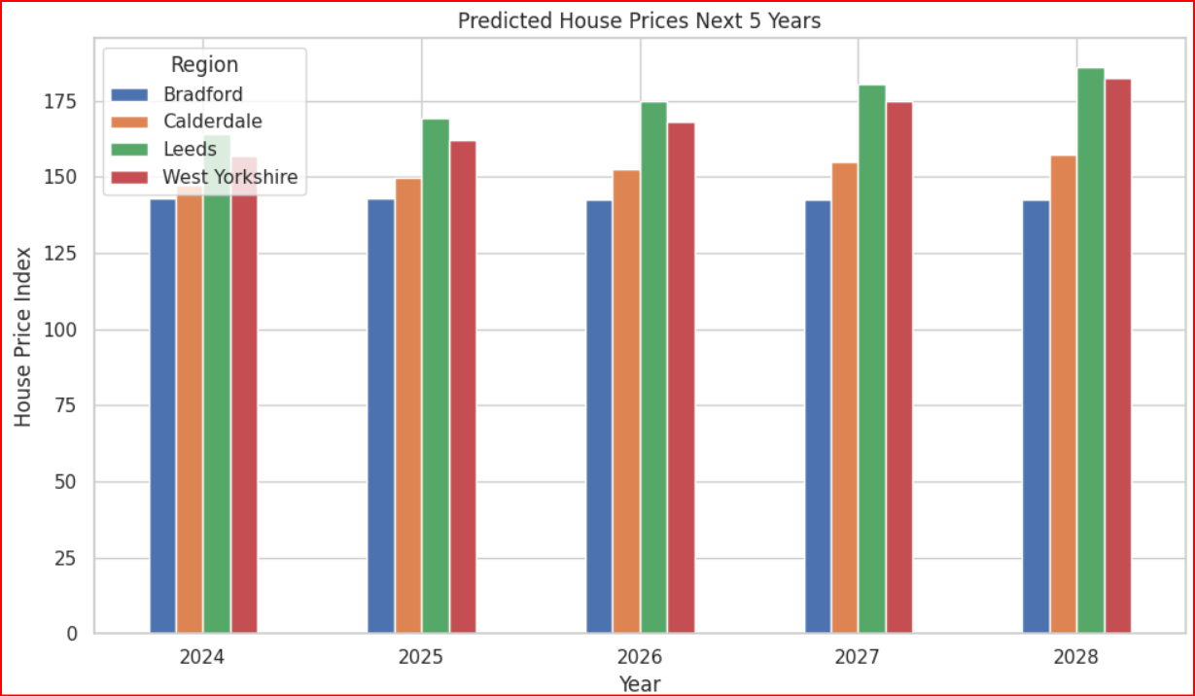
RESEARCH OUTCOME AND DISCUSSION
Deep Learning Algorithm
LSTM
GRU

Slide 12
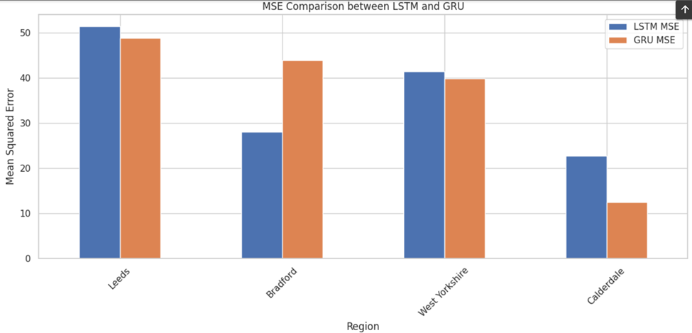
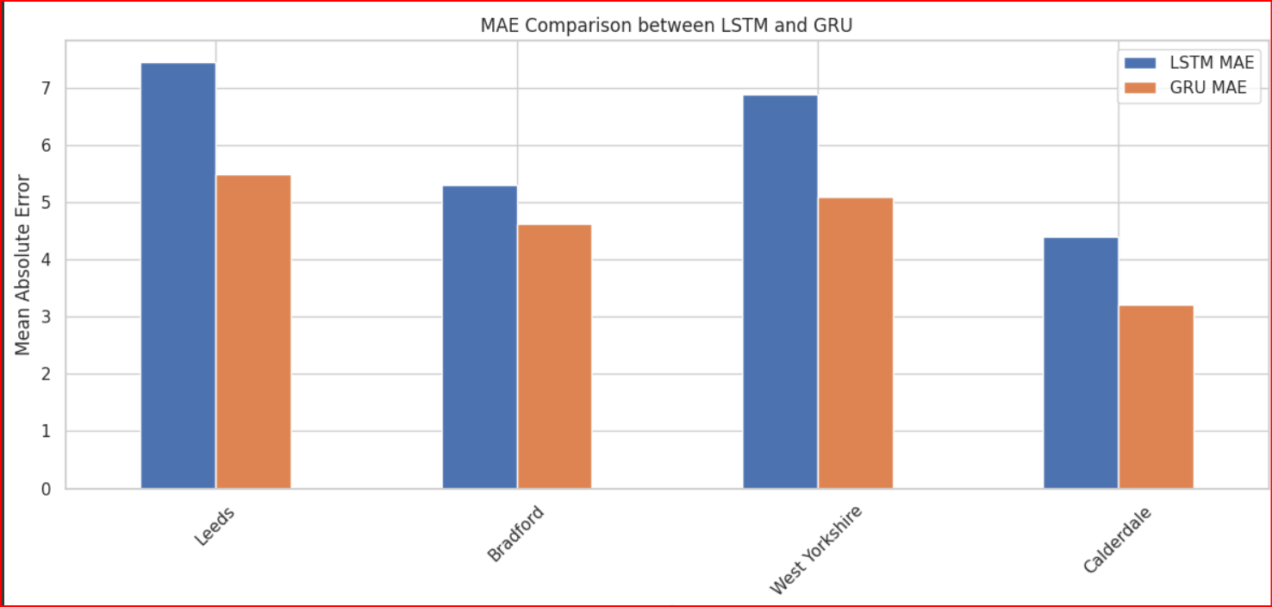
RESEARCH OUTCOME AND DISCUSSION
Comparison Between LSTM and GRU

Slide 13
CONCLUSION
The dissertation concludes that Support Vector Machines (SVM) are the best at predicting UK housing prices, but in terms of one level forward (deep learning) GRU is better than any other Model to predict House Price in UK, future research should explore additional factors and advanced methods to improve accuracy and capture market trends.
Drawbacks:
Incomplete data due to privacy regulation.
difficulty of adapting machine learning models to the rapidly changing housing market..
Future work:improve data collection, use adaptive models, integrate economic insights, ensure ethical compliance, and increase transparency

Slide 14

ETHICAL CONSIDERATIONS

Slide 15

ACKNOWLEDGEMENTS
I would like to express my sincere gratitude to my supervisor, Prof. Hadeel Jazza, for her invaluable assistance, support and encouragement to shape this project.

Slide 16

REFERENCES
Scan the QR code:

Slide 17


